Slide 1
Main Memory Lesson 1 Introduction
David Liu
Fall 2021, Spring 2022

Slide 2
Learning Outcomes
To provide a detailed description of various ways of organizing memory hardware
To discuss various memory-management techniques,
To provide a detailed description of the Intel Pentium, which supports both pure segmentation and segmentation with paging

Slide 3
Background I
Program must be brought (from disk) into memory and placed within a process for it to be run
Main memory and registers are only storage CPU can access directly
Memory unit only sees a stream of:
addresses + read requests, or
address + data and write requests

Slide 4
Background II
Register access is done in one CPU clock (or less)
Main memory can take many cycles, causing a stall
Cache sits between main memory and CPU registers
Memory unit only sees a stream of:
addresses + read requests, or
address + data and write requests

Slide 5

Protection
Protection of memory required to ensure correct operation
Need to censure that a process can access only access those addresses in it address space.
We can provide this protection by using a pair of base and limit registers define the logical address space of a process
registers

Slide 6
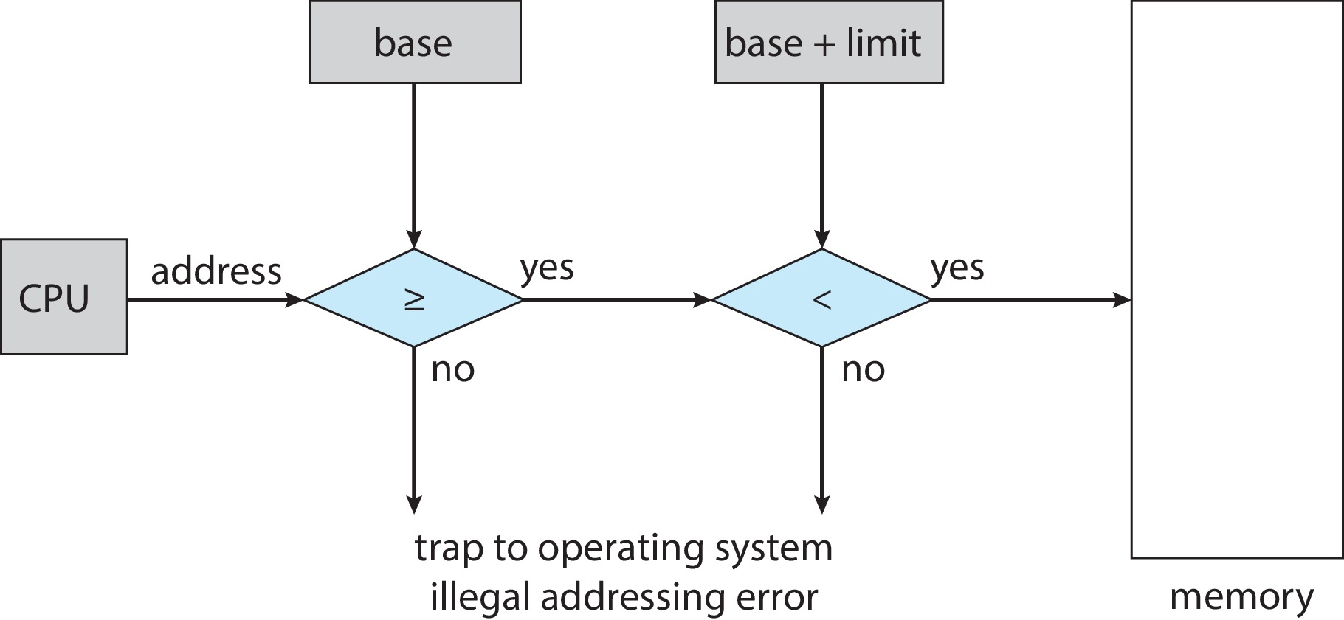
Hardware Address Protection
CPU must check every memory access generated in user mode to be sure it is between base and limit for that user process
the instructions to loading the base and limit registers are privileged
registers

Slide 7
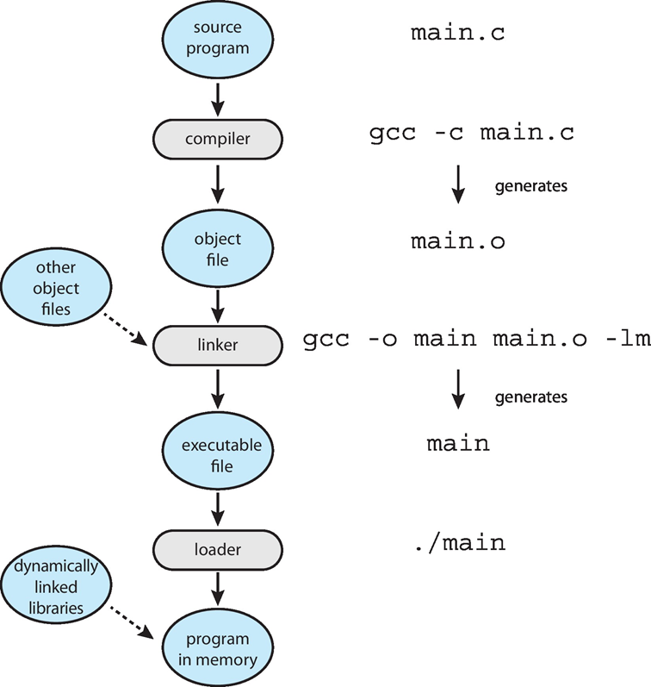
Address Binding
Programs on disk, ready to be brought into memory to execute
User process physical address can start any where in physical memory decided by OS
Addresses represented in different ways at different stages of a program’s life
Source code addresses usually symbolic
Compiled code addresses bind to relocatable addresses
i.e. “14 bytes from beginning of this module”
Linker or loader will bind relocatable addresses to absolute addresses
i.e. 74014
Each binding maps one address space to another

Slide 8

Binding of Instructions and Data to Memory
Address binding of instructions and data to memory addresses can happen at three different stages
Compile time: If memory location known a priori, absolute code can be generated; must recompile code if starting location changes
Load time: Must generate relocatable code if memory location is not known at compile time
Execution time: Binding delayed until run time if the process can be moved during its execution from one memory segment to another
Need hardware support for address maps (e.g., base and limit registers)

Slide 9
Logical vs. Physical Address Space
The concept of a logical address space that is bound to a separate physical address space is central to proper memory management
Logical address – generated by the CPU; also referred to as virtual address
Physical address – address seen by the memory unit
Logical and physical addresses are the same in compile-time and load-time address-binding schemes; logical (virtual) and physical addresses differ in execution-time address-binding scheme
Logical address space is the set of all logical addresses generated by a program
Physical address space is the set of all physical addresses generated by a program

Slide 10
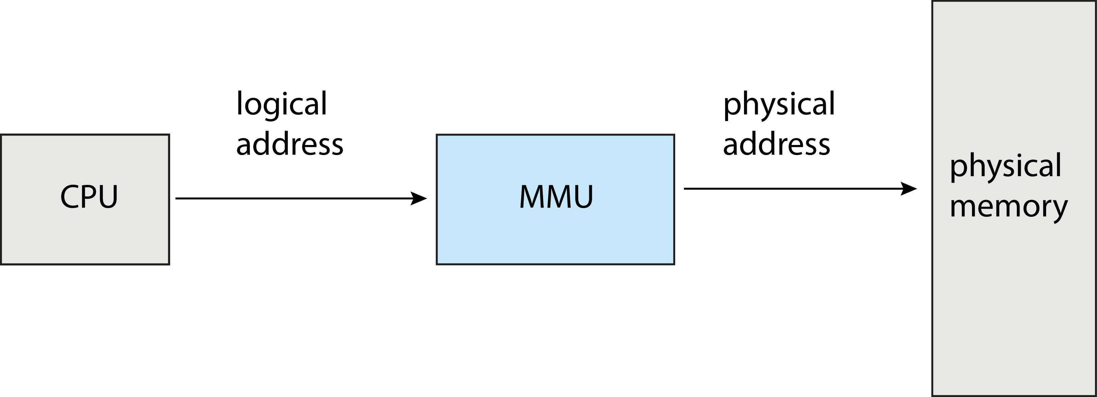
Memory-Management Unit (MMU)
Logical address space is the set of all logical addresses generated by a program
Physical address space is the set of all physical addresses generated by a program
Hardware device that at run time maps virtual to physical address

Slide 11
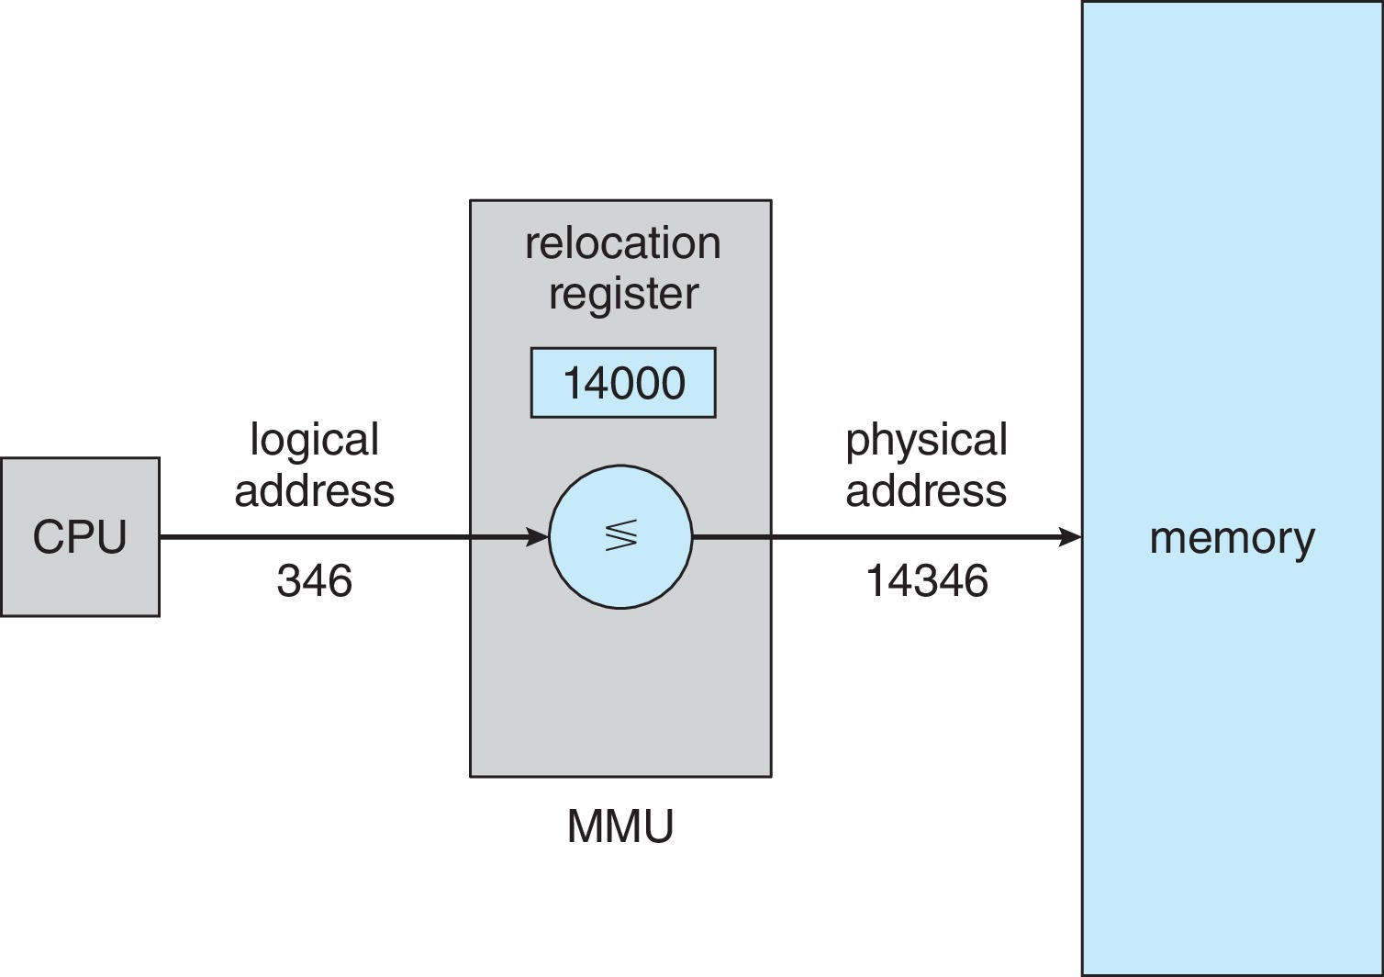
MMU Simple Mapping
Physical address =
relocation register + logical address
The base register: relocation register

Slide 12
Dynamic Loading
Entire program is not needed at all time
Code for infrequently occurring case
Solution:
Do not load a routine until it is called
Benefit:
Better memory-space utilization
No special support from the operating system is required since relocatable linking loader can be called to load the desired routine into memory

Slide 13
Dynamic Linking
Static linking – system libraries and program code combined by the loader into the binary program image
Dynamic linking –linking postponed until execution time
Small piece of code, stub, used to locate the appropriate memory-resident library routine
Stub replaces itself with the address of the routine, and executes the routine
Operating system checks if routine is in processes’ memory address
If not in address space, add to address space
Dynamic linking is particularly useful for libraries
System also known as shared libraries
Consider applicability to patching system libraries
Versioning may be needed

